Slide 1

Relational Databases
Fundamental concepts
Svetlin Nakov
National Academy for Software Development
academy.devbg.org

Slide 2

Contents
Database models
Relational database models
RDBMS systems
Tables, relations, relations multiplicity , E/R diagrams
Normalization
Constraints
Indexes

Slide 3
Contents
The SQL language
Stored procedures
Views
Triggers
Transactions and isolation levels

Slide 4
Relational databases
Database models
  Hierarchical (tree)
  Network
  Relational (table)
  Object-oriented
Relational databases
  They represent a bunch of tables together with the relations between them
  They have a strong mathematical foundation: relational algebra

Slide 5
Relational Database Management System (RDBMS)
Provide program means for:
  Creating / altering / deleting tables and relations between them
  Adding, changing, deleting, searching and retrieving of data from the tables
  SQL support
  Transaction management (optional)

Slide 6
Relational Database Management System (RDBMS)
RDBMS systems are also known as:
  Database management servers
  or simpler still "Database servers"
Famous RDBMS servers:
  Oracle Database
  Microsoft SQL Server
  IBM DB2
  PostgreSQL
  MySQL
  Borland Interbase

Slide 7
Tables
Tables are a compilation of values, ordered in rows and columns. For example (table Persons):
All rows have the same structure
Columns have a name and a type (number, string, data or other)
Id | Name | Family | Employer
1 | Svetlin | Nakov | BASD
2 | Branimir | Gjurov | BSH
3 | Martin | Kulov | CodeAttest

Slide 8
Table Scheme
The scheme of a table is an ordered sequence of descriptions of columns (name and type)
For example the Persons table has the following scheme:
PERSONS (
id: number,
name: string,
family: string,
employer: string
)

Slide 9
Primary Key
Primary key is a column of the table, that can be used to uniquely identify one of its rows
Two records (rows) are different only when their primary keys are different
The primary key can be composed from several columns (composite primary key)
Id | Name | Family | Employer
1 | Svetlin | Nakov | BASD
2 | Branimir | Gjurov | BSH
3 | Martin | Kulov | CodeAttest
Primary key

Slide 10
Relations
Relations between tables are based on interconnections primary key / foreign key
Foreign key
Primary key
Primary key
Towns
Id | Name | CountryId
1 | Sofia | 1
2 | Plovdiv | 1
3 | Munich | 2
4 | Berlin | 2
5 | Moscow | 3
Countries
Id | Name
1 | Bulgaria
2 | Germany
3 | Russia

Slide 11
Relations
The foreign key (most of the time) is a number of a record (primary key) in another table
By using relations we avoid repeating information in our database
  In the example the name of the country is not repeated for every town
Relations have multiplicity :
  1 x many – country / towns
  many x many – student / course
  1 x 1 – for example human / student

Slide 12
Relations' multiplicity
A relation 1 x many (or many x 1)
  1 record in the first table has many corresponding records in the second one Used very often
Towns
Id | Name | CountryId
1 | Sofia | 1
2 | Plovdiv | 1
3 | Munich | 2
4 | Berlin | 2
5 | Moscow | 3
Countries
Id | Name
1 | Bulgaria
2 | Germany
3 | Russia

Slide 13
Relations' multiplicity
Relationship many x many
  1 record in the first table has many corresponding records in the second one and vice versa
  Implemented through an extra table
Students
StudentsCourses
Courses
Id | Name
1 | Pesho
2 | Minka
3 | Gosho
4 | Penka
StudentId | CourseId
1 | 1
1 | 2
3 | 2
3 | 3
4 | 2
Id | Name
1 | .NET
2 | Java
3 | PHP

Slide 14
Relations' multiplicity
Relation 1 x 1
  1 record in a table corresponds to 1 record in the other table
  Models table inheritance
Professors
Primary & Foreign key in the same time
Primary key
Primary & Foreign key in the same time
Id | Title
1 | Ph.D.
Persons
Id | Name | Age
1 | Mr. Ivan | 72
2 | Goiko dude | 26
3 | Mrs. Mara | 24
Students
Id | Specialty
2 | Computer Science
3 | Chemistry

Slide 15
Representation of data organized as trees
How do we represent trees and graphs?
Svetlin
Nakov
Mario
Nadya
Peshev
Todorova
Ioana
Ivanova

Slide 16
Self-relationships
The primary/foreign key relations can point to one and the same table
  Example: employees in a company have a manager, who is also an employee
Primary key
Foreign key
Employees
Id | Name | ManagerId
1 | Svetlin Nakov | (null)
2 | Mario Peshev | 1
3 | Nadya Todorova | 1
4 | Ioana Ivanova | 3

Slide 17
Relational scheme
Relational scheme of a DB is called the collection of:
  All the schemes of all the tables
  Relations between the tables
The relational scheme describe the structure of a database
  Doesn't contain data, but metadata
Relational schemes are graphically displayed through Entity/Relationship diagrams (E/R Diagrams)

Slide 18
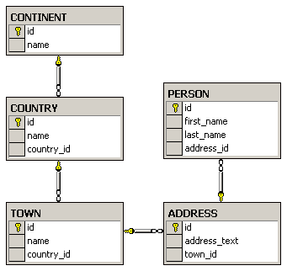
E/R Diagrams – example
The diagram is created with Microsoft SQL Server Enterprise Manager

Slide 19
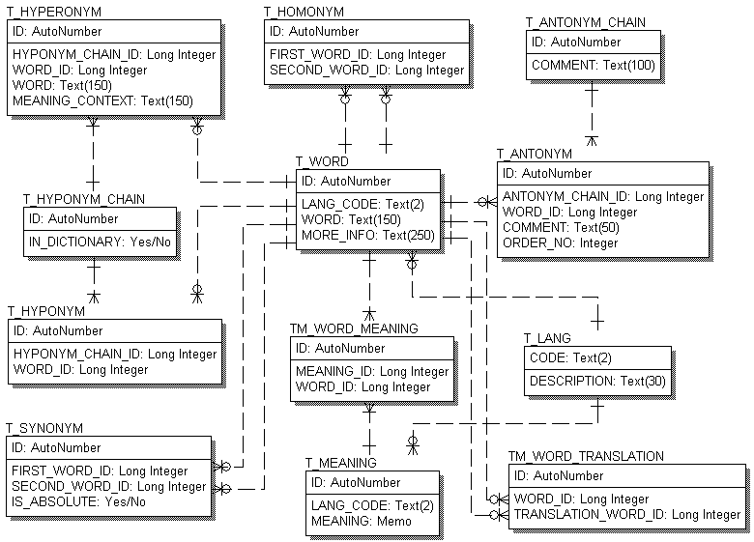
E/R Diagrams – example
The diagram is created with PLATINUM ERwin

Slide 20
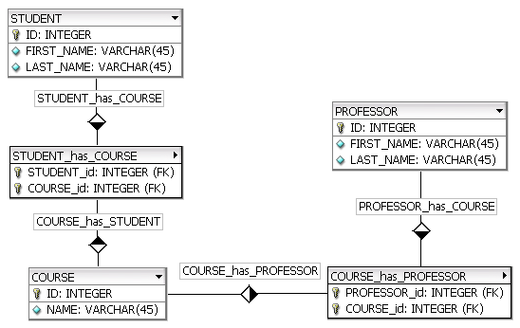
E/R Diagrams – example
The diagram is created with fabFORCE DB Designer

Slide 21
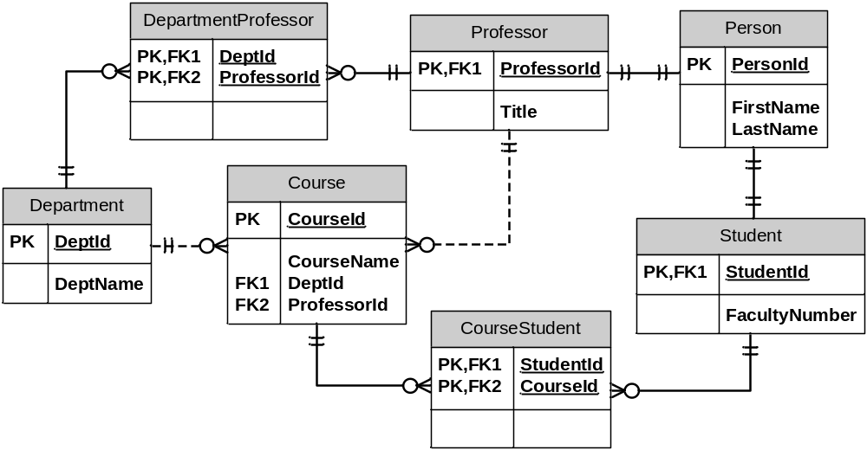
E/R Diagrams – example
The diagram is created with MS Visio

Slide 22
Tools for E/R Design
E/R diagrams are created with Data Modeling Tools:
  SQL Server Enterprise Manager Oracle Designer
  Microsoft Visio
  Computer Associates ERwin
  CASE Studio
  IBM Rational Rose
  theKompany Data Architect

Slide 23
Normalization
Normalization of the relational scheme removes repeating data
Non-normalized data contain many repetitions. For example:
Product | Producer | Price | Category | Shop | Town
Yoghurt | Mlexis LTD | 0.67 | food | store "Mente" | Sofia
bread "Dobrudja" | Bakery "Smoky" | 0.85 | food | store "Mente" | Sofia
beer "Zagorka" | Zagorka CO | 0.68 | soft drinks | stall "non-stop" | Varna
beer "Tuborg" | Shumen Drinks CO | 0.87 | soft drinks | stall "non-stop" | Varna

Slide 24
Normalization
1-st Normal Form
  Data have table appearance
  Fields in the rows are atomic (inseparable) values
  There are no repetitions within a single row
  A primary key is defined for each table
Book | ISBN (PK) | Author | AuthorEmail
.NET Framework | 3847028437 | Mr. Kiro | bai-kiro@abv.bg
Beginning SQL | 7234534450 | Santa | dedo@mraz.org

Slide 25
Normalization
2-nd Normal Form
  Retains all requirements of 1-st Normal Form
  There are no columns that depend on part of the primary key (if it consists of several columns)
The price depends on the book
E-mail depends on the author
book (PK) | Author (PK) | Price | AuthorEmail
.NET Framework | Mr. Kiro | 37.25 | bai-kiro@abv.bg
Beginning SQL | Santa | 19.95 | dedo@mraz.org

Slide 26
Normalization
3-rd Normal Form
  Retains all requirements of 2-nd Normal Form
  The only dependencies between columns are "a column depends on the PK"
Id | Product | ProducerId | Price | CategoryId | ShopId | TownId
1 | Yoghourt | 2 | 0.67 | 2 | 4 | 1
2 | bread "Dobrudja" | 3 | 0.85 | 2 | 4 | 1
3 | rakiya "Peshtera" | 6 | 6.38 | 5 | 2 | 1
4 | beer "Tuborg" | 4 | 0.87 | 4 | 1 | 3

Slide 27
Normalization
4-th Normal Form
  Retains all requirements of 3-rd Normal Form
  There is one column at most in each table that can have many possible values for a single key (multi-valued attribute)
One author can have many books
One author can have many articles
AuthorId | Book | Article
2 | .NET Programming | Regular Expressions in .NET
4 | Mastering J2EE | Best Practices in J2EE

Slide 28
Normalization
Example for a normalized scheme (in 4-th Normal Form):
Products
Id | Product | ProducerId | Price | CategoryId | ShopId | TownId
1 | Youghurt | 2 | 0.67 | 2 | 4 | 1
2 | bread "Dobrudja" | 3 | 0.55 | 2 | 4 | 1
3 | rackia "Pe6tera" | 6 | 4.38 | 5 | 2 | 1
4 | beer "Tuborg" | 4 | 0.67 | 4 | 1 | 3
Vendors
Categories
Stores
Towns
Id | Name
2 | "Mlex" ООД
4 | "Zagorka" АД
Id | Name
4 | beer
2 | food
Id | Name
1 | Billa
4 | METRO
Id | Name
1 | София
3 | Варна

Slide 29
Constraints
Constraints set data rules which cannot be broken
Primary key constraint
  Primary key is unique for each record
Unique key constraint
  Values in a column (or a group of columns) are unique

Slide 30
Constraints
Foreign key constraint
  The value in a given column is a key from another table
Check constraint
  Values in a certain column meet some condition
  For example:
    (hour>=0) AND (hour<=24)
    name = upper(name)

Slide 31
Indexes
Indexes speed up searching of values in a certain column or group of columns
Used in big tables
Usually implemented as B-trees or hash tables
They can be outer indexes (outside the table) or built-in
Adding and deleting of records in indexed tables is slower

Slide 32
The SQL language
SQL (Structured Query Language)
  Standardized declarative language for manipulation of relational databases
  SQL-99 is into use
SQL supports:
  Creating, altering, deleting tables and other objects in the database
  Searching for, retrieving, inserting, changing and deleting records

Slide 33
The SQL language
SQL consists of:
  DDL – Data Definition Language
    CREATE, ALTER, DROP commands
  DML – Data Manipulation Language
    SELECT, INSERT, UPDATE, DELETE commands
Example for an SQL SELECT query:
SELECT Towns.Name, Countries.Name
FROM Towns, Countries
WHERE Towns.CountryId = Countries.Id

Slide 34
Stored Procedures
Procedures at database level (stored procedures)
  Code executed on the very database server
  Much faster than an outer code
  Data is locally accessible
  Can accept parameters
  Can return result
    single value
    record set

Slide 35
Stored Procedures
Procedures at database level are written on a language extension of SQL
  PL/SQL – in Oracle
  T-SQL – in Microsoft SQL Server
A stored procedure in PL/SQL:
CREATE OR REPLACE PROCEDURE spInsertCountry(countryName varchar2) IS
BEGIN
INSERT INTO Countries(Name)
VALUES(countryName);
END;

Slide 36
Views
Views are named SQL SELECT queries which are used as tables
Facilitate writing of complex SQL queries
Also used to do fine security adjustments:
  A certain user isn't given permissions on any of the tables
  He is given permissions on some of the views only (a subset of data)

Slide 37
Views – Example
V_Companies
V_Towns
Id | Company | TownId
1 | Mente LTD | 1
2 | BulkSoft Inc. | 2
3 | HardSoft CO | 4
4 | Sputnick CO | 3
Id | Town | CountryId
1 | Sofia | 1
2 | New York | 3
3 | Moscow | 2
4 | Plovdiv | 1
Id | Country
1 | Bulgaria
2 | Russia
3 | USA
V_Countries

Slide 38
Views – Example (2)
CREATE VIEW V_BGCompanies AS
SELECT
V_Companies.Id AS Id,
V_Companies.Company AS Company
FROM V_Companies INNER JOIN
(V_Towns INNER JOIN V_Countries ON
V_Towns.CountryId= V_Countries.Id)
ON V_Companies.TownId= V_Towns.Id
WHERE
V_Countries.Country = "Bulgaria";
Id | Company
1 | Mente LTD
3 | HardSoft CO
V_BGCompanies

Slide 39
Triggers
Triggers are database level procedures that activate when some event occurs, for instance:
  When inserting a record
  When changing a record
  When deleting a record
Triggers can perform additional data processing
  To change the newly added data
  Support for logs and history

Slide 40
Triggers – Example
We have a table with company names :
A trigger that appends an "Ltd." at the end of the name of a new company:
CREATE TABLE Companies(
Id number NOT NULL,
Name varchar(50) NOT NULL)
CREATE OR REPLACE TRIGGER trg_Companies_INSERT
BEFORE INSERT ON Company
FOR EACH ROW
BEGIN
:NEW.Name := :NEW.Name || ' Ltd.';
END;

Slide 41
Transactions
Transactions are a sequence of actions (database operations) which are executed as a whole:
  Either all of them execute successfully
  Or none of the them
Example:
  A bank transfer from one account into another (withdrawal + deposit)
  If either the withdrawal or the deposit fails the whole operation is cancelled

Slide 42
A Transaction
Read
Write
Durable starting state
Write
Collection of reads and writes
Commit
Durable,
consistent,
ending state
Rollback
Notes:
<number>##
<footer>*
<header>*
Two possible outcomes of the transaction: It completes successfully (as agreed by unanimous vote of all its participants) or it fails and rolls back to the state before the transaction started
Durable: if the transaction didn’t occur, this state would persist
Analogy: A contract negotiation either results in a successful signed contract, or it fails. There is no intermediate. Similarly, once it is signed, it exists as a whole, it cannot be broken into pieces. It is also durable, lasting as long as specified within the contract.

Slide 43
Transactions Behavior
Transactions guarantee the consistency and the integrity of the database
  All changes in a transaction are temporary
  Changes become final when COMMIT is executed
  At any time all changes can be canceled by ROLLBACK
All of the operations are executed as a whole, either all of them or none of them

Slide 44
Transactions: Examples
Withdraw $100
Transfer $100
Read current balance
New balance =
current - 100
Write new balance
Dispense cash
Read savings
New savings =
current - 100
Read checking
New checking =
current + 100
Write savings
Write checking

Slide 45
Transactions Properties
Atomicity
  Either execute everything or nothing
Consistency
  The database remains consistent with logically correct data
Isolation
  Different transactions are isolated from each other depending on the selected isolation level
Durability
  If a transaction is confirmed, it cannot be lost

Slide 46
Transactions – Example
We have a table with bank accounts:
We use a transaction to transfer money from one account into another
CREATE TABLE Accounts(
Id int NOT NULL,
Balance decimal NOT NULL)
CREATE OR REPLACE PROCEDURE sp_Transfer_Funds(
fromAccount IN INT,
toAccount IN INT,
ammount IN NUMBER) IS
BEGIN

Slide 47
Transactions – Example
UPDATE Accounts set Balance = Balance - ammount
WHERE id = fromAccount;
IF SQL % ROWCOUNT = 0 THEN
ROLLBACK;
RAISE_APPLICATION_ERROR(-20001, 'Invalid src account!');
END IF;
UPDATE Accounts set Balance = Balance + ammount
WHERE id = to_account;
IF SQL % ROWCOUNT = 0 THEN
ROLLBACK;
RAISE_APPLICATION_ERROR(-20002, 'Invalid dst account!');
END IF;
COMMIT;
END;

Slide 48
Transactions and Isolation
Transactions can define different isolation levels
  The stronger isolation ensures better consistency but works slower and the data is locked longer
Level of isolation | Dirty reads | Repeatable reads | Phantom reads
Read uncommitted | yes | yes | yes
Read committed | no | yes | yes
Repeatable read | no | no | yes
Serializable | no | no | no

Slide 49
Transactions Usage
When to use transactions?
  Always when a business operation accesses more than one table
  Example:
    At the register of a store: we buy a cart of products
    We either buy all of them and pay or we buy nothing and give no money
  If any of the operations fails we cancel the transaction (the purchase)

Slide 50
Questions?

Slide 51
Exercises
What database models do you know?
Which are the main functions performed by a Relational Database Management System (RDBMS)?
Define "table" in database terms.
Explain the difference between a primary and a foreign key.
Point out the different types of relationships between tables.
When is a certain database normalized? What are the advantages of a normalized database?

Slide 52
Exercises (2)
What are constraints used for in a database?
Point out the pros and cons of using indexes in a database.
What's the main purpose of the SQL language?
What are transactions used for? Define their responsibilities and explain their isolation levels.

